Slide 1

Group 10 Rahul Kevadia 0702769 Amriteshwar Singh 0720042 Kaining Huang 0690090 Guided by Fadi Alzhouri
Comparative Study of English and Russian Language Tweets in Ukraine-Russian Special Military Operation Dataset

Slide 2
Abstract
Social media has become a significant tool for disseminating information and influencing opinions and decisions.
Social media is having an increasing impact on political discourse allowing institutions and citizens to connect directly and participate actively in political decision-making processes.
In this paper, we presented methods to improve the quality of the applied sentiment analysis studies. We are trying to compare the sentiment of the Russian Language Tweets with the same tweets translated into English. Moreover, we have also performed sentiment analysis of Russian language tweets and tried multiple techniques to improve the quality of the sentiment lexicon in the Russian Language.

Slide 3
Introduction
Predicting, Inspecting, and Analysis of tweets on special military operations using computational power to gather information about a certain subject. With the use of Natural Language Processing and the concept of Machine Learning, we can train the computer to classify tweets from the dataset.
Our Survey differs from the existing literature survey in that we focus on the application of sentiment analysis rather than existing sentiment analysis approaches and their classification quality. This work is about the Sentiment analysis of tweets posted on Twitter. BERT (Bidirectional Encoder Representations from Transformers) is the NLP (Natural Language Processing) Model, to predict the masked word from the tweets of the user for a special military operation. It is specially designed to use a masked language model, or MLM, to pre-train deep bidirectional representations from the unlabeled text. The processing of the data takes place and generally consists of two steps, pre-training and fine-tuning for creating models and a wide range of tasks.

Slide 4
Problem definition
Using the dataset from Kaggle, Ukraine Conflict Twitter Dataset[7]. This data contains 36.28 million tweets and around 11 Giga Bytes datasets in the form of Binary data about the conflict and is updated every day. The dataset consists of multiples columns such as userid, username, access (user bio), location, following (count), followers (count), total tweets, usercreatedts (time), tweeted, tweetcreatedts (time), retweet- count, text, hashtags, language, coordinates, favorite count, extracted (time).
More than 150 languages are identified by linguistic experts. We translate the sentiment scales from Russian into English languages to classify simple monolingual sentiment analysis by translating the text into a single language. We observe that the sentiment polarity of the Russian language and English language are different for the same tweets. In this paper, we compare the Russian and English-translated tweets and find the solution for the difference we observed while analyzing the same tweets in two different languages.

Slide 5
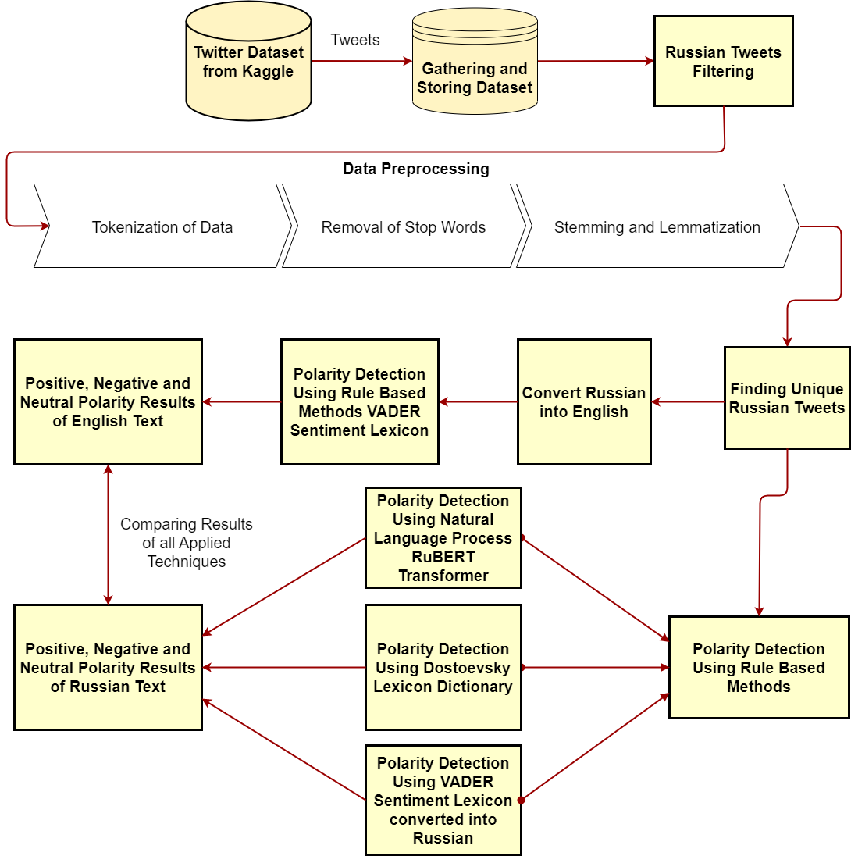
System architecture
Fig. 1. System Architecture / System Flow Diagram

Slide 6
Problem formulation
In all Four Methods, the texts were categorized into 3 classes: Negative, Neutral, and Positive. Before implementing all the methods, data has been through the process of data pre-processing methods: Tokenization and Stemming to understand better. We extract 1455 Russian texts from the data set and translate the unique ones into the English language. They are all analyzed by the VADER lexicon sentiment analysis. VADER is an English language lexicon and rule-based sentiment analysis tool. To analyze the sentiments in VADER we calculate the compound score by adding the valence score of every word in the lexicon followed by the rule and then normalizing between -1 to +1.

Slide 7
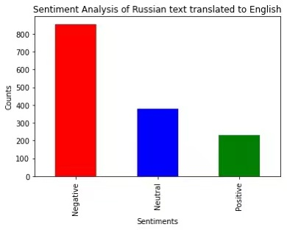
Sentiment Analysis of Russian text translated to English
In Fig. 2 we observe that all the tweets are divided into 3 classes: Negative, Neutral, and Positive. We found the majority of tweets were classified as negative and almost equal proportions were classified as Neutral and Positive. Each of them did not reach half of the negative tweets.
Fig. 2. Sentiment Analysis of Russian Text Translated to English

Slide 8
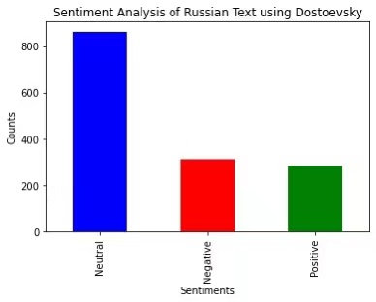
Sentiment Analysis of Russian text using Dostoevsky
In the next approach, we applied the sentiment analysis library: Dostoevsky package on Russian texts and categorized texts into the same classes as in the first approach. As shown in Fig. 3 most tweets were classified as Neutral, Positive and negative tweets did not reach half of the neutral ones and they almost took equal proportion. The result of this approach is not similar to which of translating Russian text into English.
Fig. 3.
Sentiment Analysis of Russian Text

Slide 9
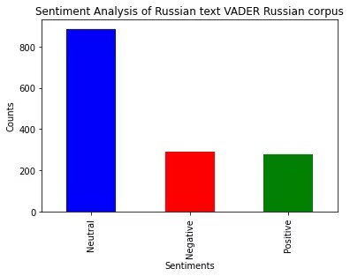
Sentiment Analysis of Russian Text VADER Russian Corpus
Next, refactoring of the source code for the VADER sentiment lexicon was performed for the Russian language. In this approach, we extracted the words list from the VADER sentiment lexicon and translated them to Russian assuming that the intensity rating will be consistent after translation. After updating the intensity rating for all the English words to corresponding Russian ones, we run the same code to calculate the sentiment intensity for Russian text and the result can be observed in Fig. 4. We didn’t get the expected outcome, but our results were similar to the results obtained from the second approach using Dostoevsky library.
Fig. 4.
Sentiment Analysis of Russian Text VADER Russian Corpus

Slide 10
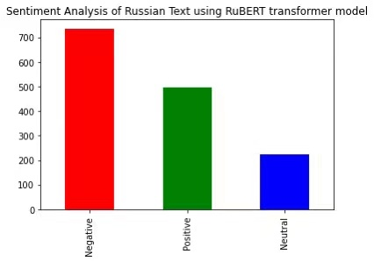
Sentiment Analysis of Russian Text using RuBERT model
Finally, the RuBERT model was performed in the sentiment analysis. As presented in Fig. 5, we found negative tweets take the majority, which was similar with the result of translating Russian to English. In addition, such a result is consistent with English Tweets sentiment analysis. Thus, the outcome produced by performing RuBERT transformer model was the most ideal for our sentiment analysis.
Fig. 5.
Sentiment Analysis of Russian Text using RuBERT transformer model

Slide 11
Challenges
Computational cost:
The computational cost starts with downloading the 11 Gigabytes Ukraine Russia Conflict dataset from Kaggle, which requires a good internet connection and storage space on the disk. Additionally, the dataset contains a collection of gzip files, accessed using a for loop and decompressed simultaneously.
• Implementing the Dostoevsky package:
The main challenge is to install its dependencies. It requires the C++ build tools to install all dependencies of this package. Therefore, we installed 25 Gigabytes tools in the system.
• Converting VADER lexicon word into Russian:
We have to translate all the English words available in the VADER lexicon.

Slide 12
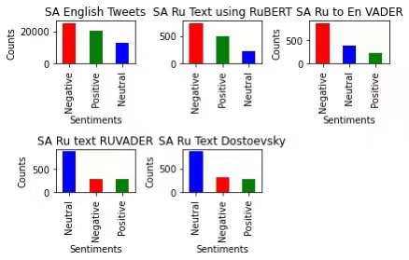
Simulation results
The results indicate that the sentiment analysis performed in the Russian language using the RuBERT model shows the same pattern as the VADER sentiment in English as shown in comparison. Thus, the RuBERT Transformer gives the best solution because the pattern of classification matches with the VADER classification, performing the best among all the methods.

Slide 13
Discussion
The results of sentiment analysis using VADER lexicon after translation and RuBERT model are still dissimilar in counts of positive and neutral tweets. Opposition claims might argue the results are inconsistent. However, in both methods, the counts of negative tweets take the majority. In addition, the result of RuBERT model is consistent with that of English sentiment analysis.

Slide 14
Conclusion
The military conflict between Russia and Ukraine becomes the centroid of social media after eruption, attracting people to post and comment about this event. Our research includes:
• Extract and gather multilingual tweets into the dataset.
• Process data to be in the state that a machine can interpret.
• Conduct sentiment analysis on English tweets.
• Conduct sentiment analysis on tweets in Russian languages by VADER lexicon after translating into English, Dostoevsky package, VADER for Russian, and RuBERT model.
• Compare the results of sentiment analysis using these methods.
In the future, research can be done to decrease the dissimilarity of results by performing VADER lexicon after translation and RuBERT model.

Slide 15
References:
[1] ”Multitask Learning for Fine-Grained Twitter Sentiment Analysis”, Georgios Balikas, Simon Moura, Massih-Reza Amini (Issue 2017)
[2] Sentiment Analysis of Twitter Data for Predicting Stock Market Movements”, Venkata Sasank Pagolu, Kamal Nayan Reddy Challa, Ganapati Panda, Babita Majhi (Issue 2016)
[3] ”VADER: A Parsimonious Rule-based Model for Sentiment Analysis of Social Media Text”, C.J. Hutto Eric Gilbert (Issue 2015)
[4] ”Transformer Based Multi-Grained Attention Network for Aspect-Based Sentiment Analysis”, JIAHUI SUN 1, PING HAN 2, ZHENG CHENG 1, ENMING WU 1, AND WENQING WANG (Issue 2020)
[5] ”Distributed Real-Time Sentiment Analysis for Big Data Social Stream.”, Amir Hossein Akhavan Rahnama. (Issue 2016)
[6] ”Integrated Real-Time Big Data Stream Sentiment Analysis Service.”, Sun Sunnie Chung, Danielle Aring, (Issue 2018)
[7] https://www.kaggle.com/datasets/bwandowando/ukraine-russian-crisis- twitter-dataset-1-2-m-rows
[8] “Identifying top sellers in underground economy using deep learning- based sentiment analysis,” in Proc. IEEE Joint Intell. Secur. Informat. Conf., W. Li and H. Chen (Issue 2014)
[9] “Sentiment-analysis-in-russian: Fine-tuned multilingual Bert and multilingual use for sentiment analysis in Russian. Rureviews, Rusentiment, Kaggle Russian news dataset, LINIS crowd, and RuTweetCorp were utilized as training data.” Sismetanin. (Issue 2021).

